Slide 1

Health Status Website
By:- Navdeep Mehta

Slide 2

About Project
This website will help you to know about health status or healthy we are using the various measures such as blood sugar level, lower and higher blood pressure, heart rate, temperature and hemoglobin of a student. It also suggest advice based on the given information by the student.

Slide 3
Hardware & Software requirements
Hardware requirements
Windows 10 or newer
4 GB or more RAM
I5 or higher Processer
Software requirements
XAMPP
VS Code
Programming language
PHP
HTML & CSS
Database used
MySQL

Slide 4
Software Used
XAMPP
VS Code
The Apache HTTP Server, MariaDB database, and interpreters for scripts written in the PHP and Perl programming languages are the core components of XAMPP, a free and open-source cross-platform web server solution stack bundle created by Apache Friends.
Microsoft created the source-code editor Visual Studio Code, generally known as VS Code, for Windows, Linux, and macOS using the Electron Framework. Debugging support, syntax highlighting, intelligent code completion, snippets, code refactoring, and embedded Git are among the features.

Slide 5
Languages Used
PHP
HTML & CSS (For Designing)
PHP is a free, server-side, open-source programming language that may be used to build websites, programmes, CRM systems, and more. It is a popular all-purpose language that can be integrated into HTML.
The preferred markup language for documents intended to be viewed in a web browser is HTML, It describes the purpose and organization of web content. It frequently benefits from tools like Cascading Style Sheets and programming languages like JavaScript.
A style sheet language called Cascading Style Sheets is used to describe how a document published in a markup language like HTML or XML is presented.

Slide 6

MySQL
The most widely used open-source database worldwide is MySQL. Because of its demonstrated performance, dependability, and usability, MySQL has emerged as the top database of choice for web-based applications, encompassing everything from personal websites and projects to high-profile websites like Facebook, Twitter, YouTube, and Yahoo!.

Slide 7
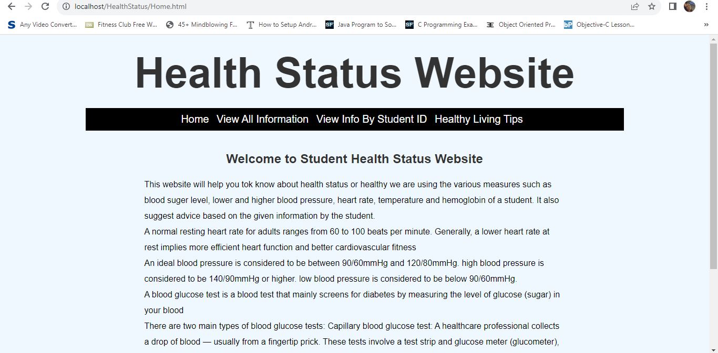
Home Page

Slide 8
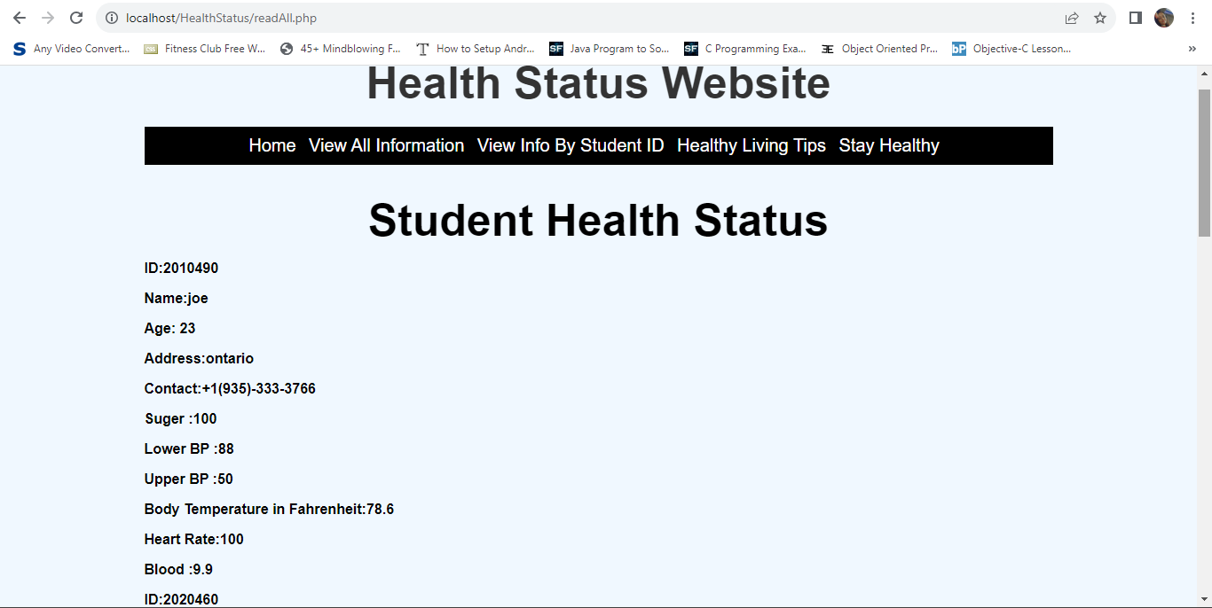
View Health Information

Slide 9
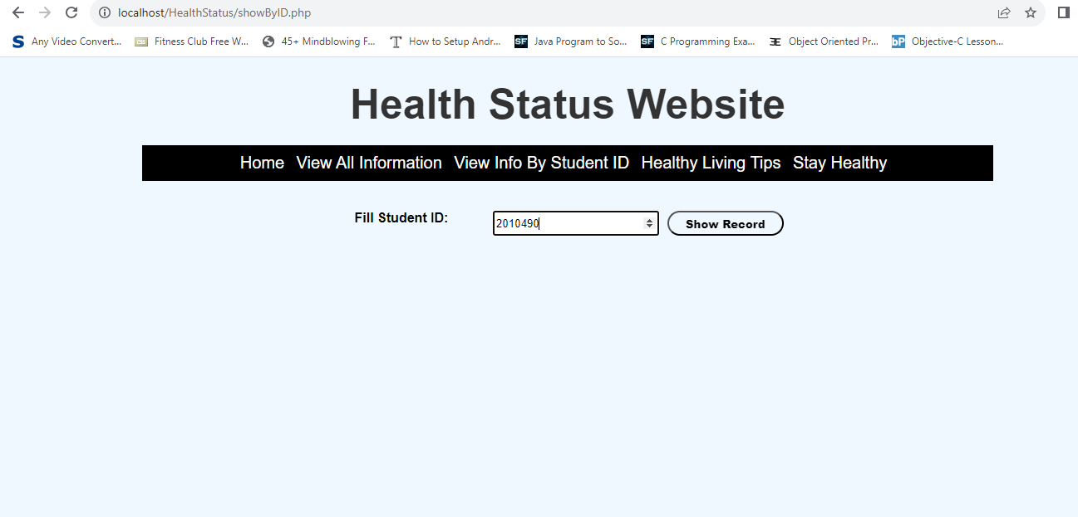
View Info By Student ID

Slide 10
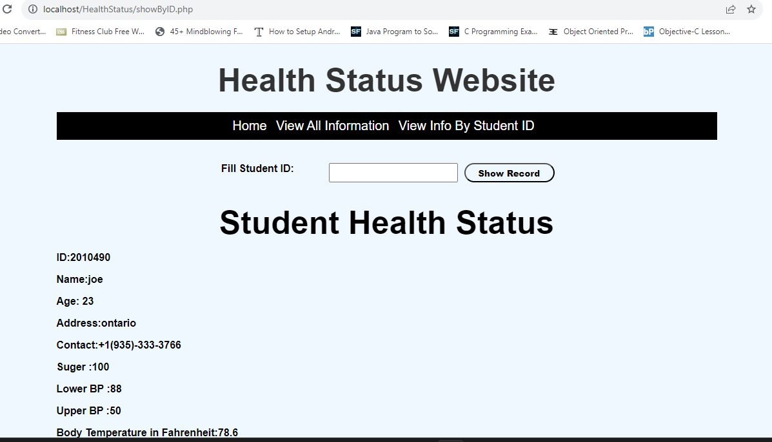
View Info By Student ID (Output)

Slide 11

View Info By Student ID (Validating output)

Slide 12
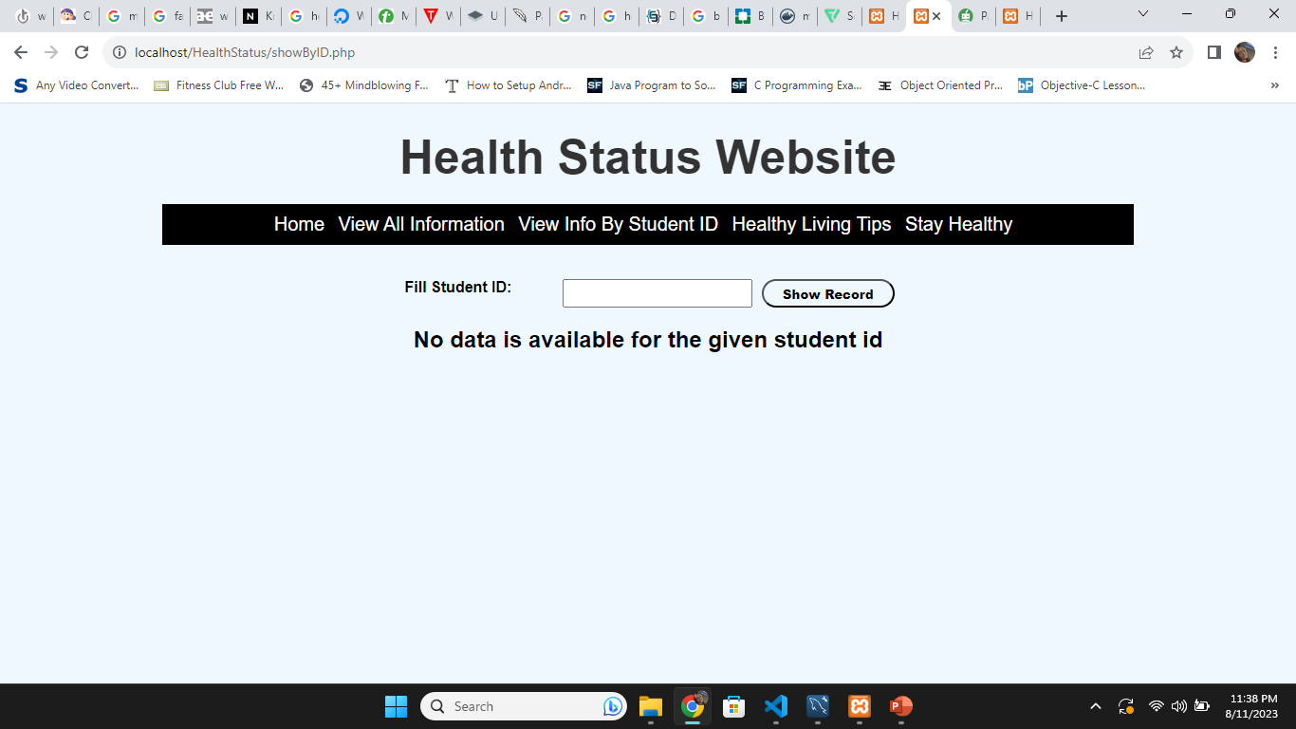
View Info By Student ID (No Record Exist)

Slide 13
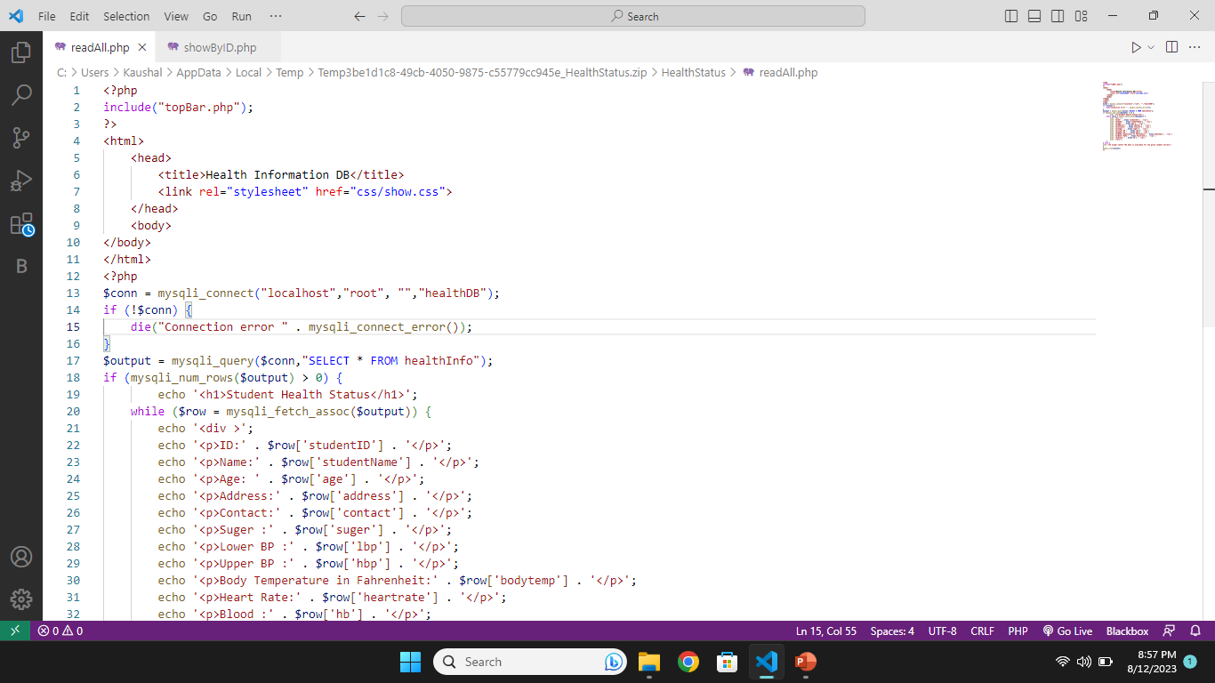
Coding Screenshot (readAll.php)

Slide 14
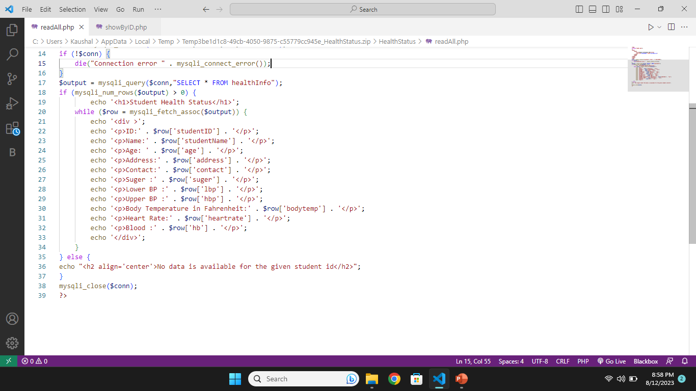
Coding Screenshot (readAll.php)

Slide 15
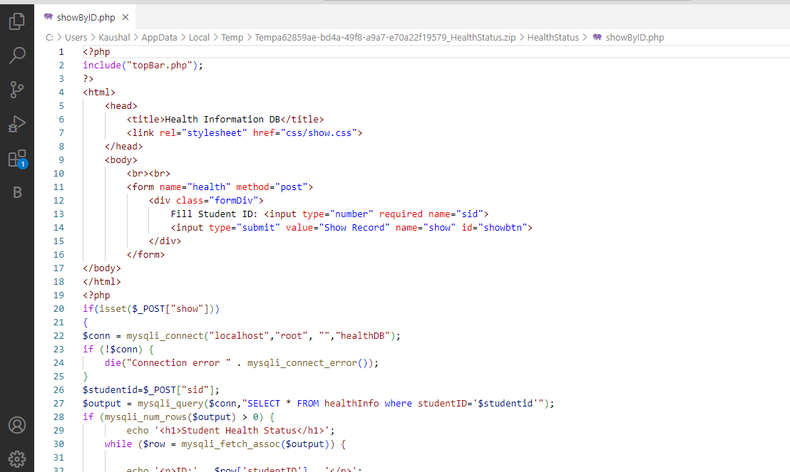
Coding Screenshot (showByID.php)

Slide 16
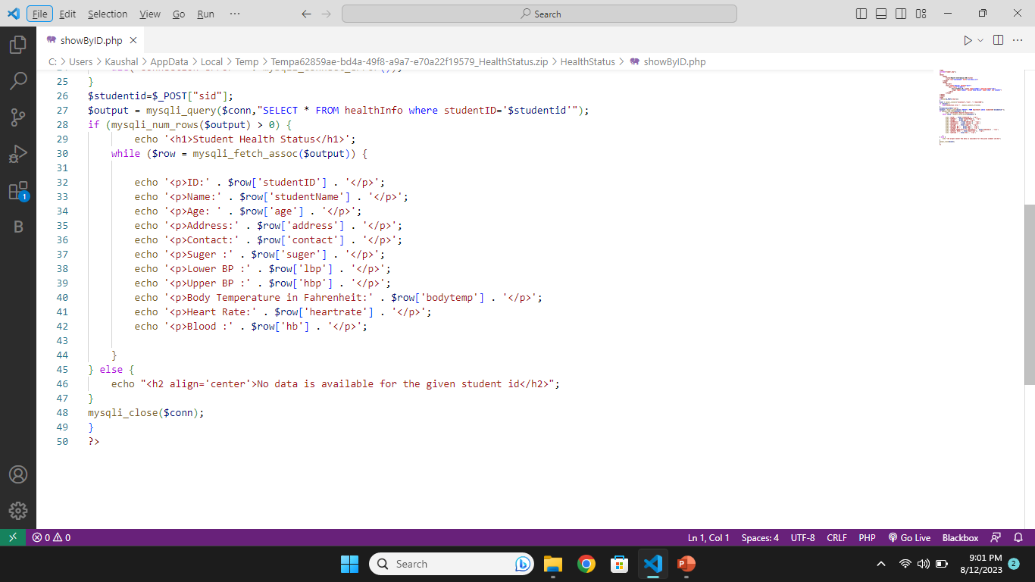
Coding Screenshot (showByID.php)

Slide 17
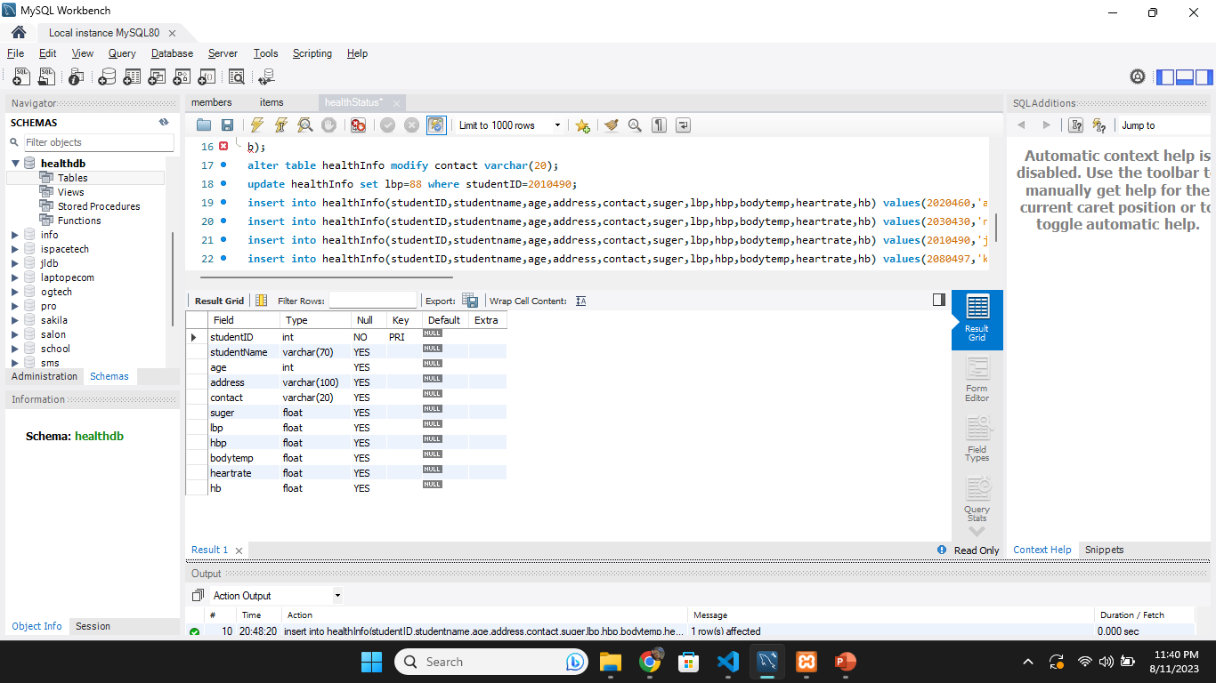
Database & Table
Database: healthDB
Table: healthInfo

Slide 18

Thank You..

